Slide 1
INDOOR NAVIGATION SYSTEM
Clyde Noronha
Mustafa Zaki
Shane Gracias
Ruman Mulla

Slide 2
OBJECTIVE
The objective of this project is to provide users with the ability to navigate indoors accurately with the help of the magnetic sensor available in smartphones.

Slide 3
INTRODUCTION
Magnetic positioning was inspired by animal wayfinding in nature (e.g., birds, bats, bees, salmon, foxes, etc.)
Smartphones are similarly able to detect and respond to magnetic field variations inside buildings.

Slide 4
Magnetic Fields Inside Buildings
Earth’s magnetic field is present everywhere.
Ambient magnetic fields indoors comprise of disturbances in the Earth’s magnetic field caused by the ferromagnetic nature of the building’s steel structure.
This distortion of the magnetic field is precisely what enables it to locate people indoors.
Steel and concrete help create the unique magnetic fingerprints or signatures of buildings.
Smartphone owners (iOS and Android) can then be accurately located inside retail stores, hospitals, malls, airports and other indoor spaces.

Slide 5
INADEQUACY OF GPS INDOORS [4]
A GPS device relies on a series of satellites in order to determine where it is physically located.
A GPS works better when the device has a clear line of sight to the sky. The more GPS satellites that your personal device can access, the more accurate it is. When inside, there is often no direct line from the satellite signals to your device.
When you use a GPS inside a building, the signals from the satellites are attenuated and scattered by roofs, walls and other objects.

Slide 6
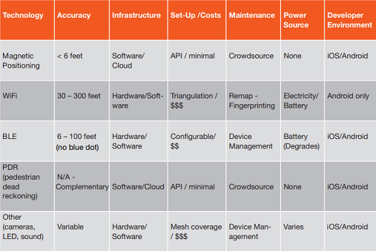
Comparing Technologies: WiFi, BLE and Magnetic [3]

Slide 7
Why Magnetic Field?
GPS is inaccurate indoors.
No external hardware required.
Minimum Cost.
Accurate.

Slide 8
CHALLENGES [1]
Built-in sensor variation
Different smartphones consist of different models of built-in magnetic field sensors that vary in their sensitivities.
Long-term variation
Long-term variations in the environment itself could be a cause for changes in the magnetic signatures. Long-term variation is the change in the magnetic field magnitudes over a certain period of time.

Slide 9
CHALLENGES
Presence of personal metallic objects
Presence of small metallic objects (key chains, coins) in the user’s pocket along with the smartphone could affect the magnetic signatures.
Device placement
Since we are only considering the overall squared magnitude of the magnetic field and not the magnitude of individual axes, the placement of the phone should not cause any problems in our work.

Slide 10
CHALLENGES
Presence of furniture
Presence of furniture
The other factor that we speculate could affect the magnetic signatures is the presence of furniture along hallways. Unless the furniture consists of heavy metallic objects that are frequently replaced, we believe there would not be any issue with the system.

Slide 11
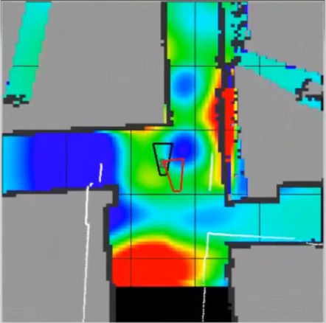
WORKING [2]
Key Concept
GEOMAGNETIC FINGERPRINTS
Anomalies caused by magnetic disturbances
of the Earth’s geomagnetic field can be used as
a “fingerprint” to describe the environment - the
more variable the local anomalies, the more
unique is the fingerprint.

Slide 12
WORKING
The essence of indoor positioning based on geomagnetic field is geomagnetic matching.
Geomagnetic Matching - Magnetic data collected by the user will be matched against the magnetic map of the building which is stored on a cloud, in order to accurately position the user.

Slide 13
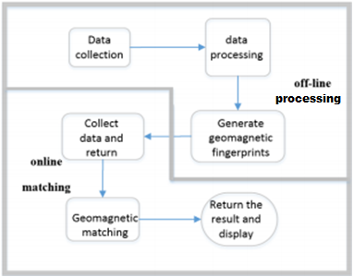
WORKING
GEOMAGNETIC POSITIONING
Geomagnetic positioning method can be divided into two stages: offline processing and online matching.
OFFLINE PROCESSING
The main purpose of the offline processing is to generate geomagnetic fingerprints.
ONLINE MATCHING
The main purpose of online matching is for real-time positioning of the user.

Slide 14
WORKING
MODULES – OFFLINE PROCESSING
DATA COLLECTION
This module collects the geomagnetic signals of the current location through the mobile device at the time of data pre-acquisition and positioning.
DATA PROCESSING
This module is responsible for preprocessing the collected data, such as using a filtering algorithm and other methods to reduce the error, as well as transforming the data into coordinates to obtain the geomagnetic fingerprint.

Slide 15
WORKING
MODULES - ONLINE MATCHING
GEOMAGNETIC MATCHING
This module is responsible for the operation of the system - upon receiving the current geomagnetic signal from smart phone, it returns the positioning result.
DISPLAY
This module mainly displays the map, the positioning interface and displays the positioning result once the data is collected, preprocessed and matched.

Slide 16
WORKING
ALGORITHMS
Filtering Algorithms
They are used to reduce or remove the amount of interference in the geomagnetic data, such as the fluctuating point caused by sudden jitter or tilt of the smart phone while collecting data. Ex. Median Filter, Mean Filter, Difference Filter.
Coordinate Transformation Algorithm
It is used to convert the 3-dimensional geomagnetic and direction sensor data into 2-dimensional coordinate s of a room.
Geomagnetic Matching Algorithm
The established geomagnetic fingerprint map is compared with real-time data of the user in order to accurately position the user. Ex. Euclidean distance.

Slide 17
FURTHER IMPLEMENTATION
Indoor Hospital map.
Crowdsourcing for creating maps of various places.
Arduino for quicker and more stable collection of data.

Slide 18
REFERENCES
LocateMe: Magnetic-fields-based Indoor localization using smartphones –Kalyan Pathapati Subbu, Brandon Gozick, and Ram Dantu
The Design and Implementation of Indoor Localization System Using Magnetic Field Based on Smartphone - Liu Jiaxing, Jiang Congshi, Shi Zhongcai
Magnetic Positioning, Opus Research – Greg Sterling
https://itstillworks.com/doesnt-gps-work-inside-building-18659.html

